Slide 1
Analysis of water sample
Team Members- Project’s Guides-
Rohan Arora (1610991724) Dr. Jyotsna Kaushal
Rohan Gaur (1610991725) Ms. Priyanka Dua
Riya Puri(1610991719) Mr. Ajay Singh
Rupali(1610991737)
Rudra(1610991736)
Project no.-Assessment of Water Quality Parameters

Slide 2
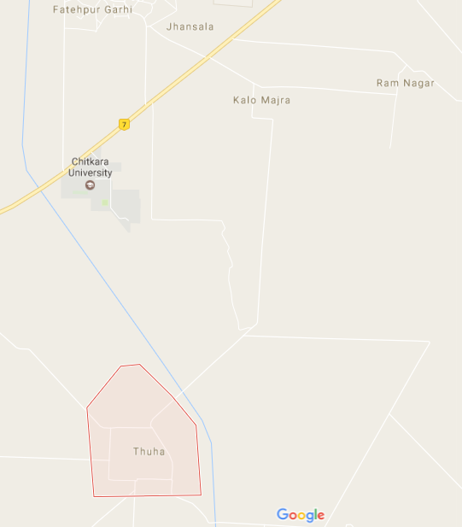
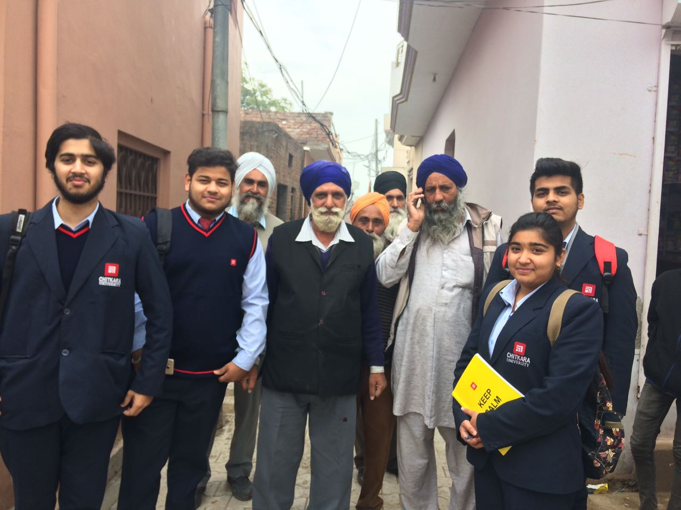
Village Thuha-
Village Thuha is situation nearby
The village has 2100 votes.
There are 500 housed in which 200 motors are there.
500litre tank is there in the entire village.
Bore wells are dig around 650 feet and use of hand pump has been reduced.

Slide 3
Problem faced by the Village’s People-
1. Hardness like temporary , permanent , extent of residual chlorine, bacteria , dissolved oxygen are thereby responsible for chemical contamination in water.
2. Due to these factors mankind has lots of suffering physically and mentally.
3. They are more prone to diseases like stones in kidneys etc .
4. Unlikely these diseases have become the part of their lives so they have dig the bore wells even more deeper i.e. 650 feet below the avg. ground level.
5. Digging the bore wells even more deeper has reduced many failures like color, taste and hardness which has given a sign of relief to the mankind.

Slide 4
Parameters over which Water analysis is done
Dissolved Oxygen
C.O.D
Hardness
Residual Chlorine
pH
TDS

Slide 5
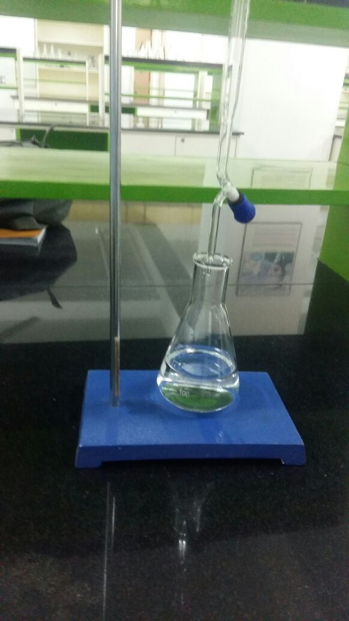
Dissolved Oxygen-
Precipitation
Dissolution of organic matter
Dissolved Oxygen (in ppm)
Water sample after being titrated
Solubility increase
Increase in pressure
Increases in conc. Of salts

Slide 6
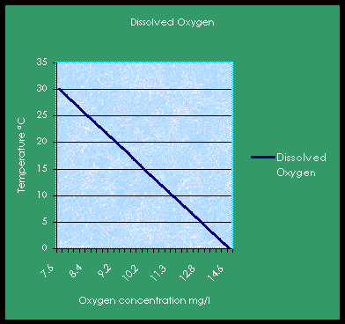
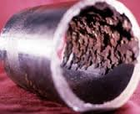
Variation of dissolved oxygen with temperature
Industries
( boiler corrosion)
Aquatic life
Effect of low and high DO in water

Slide 7
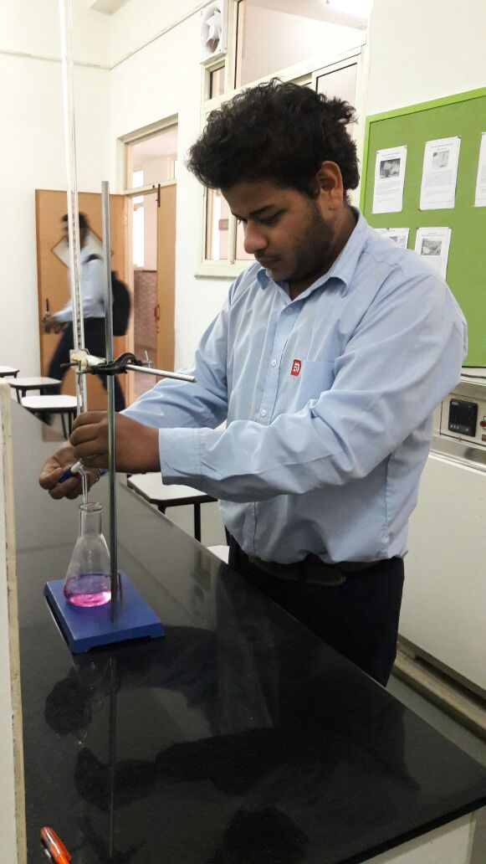
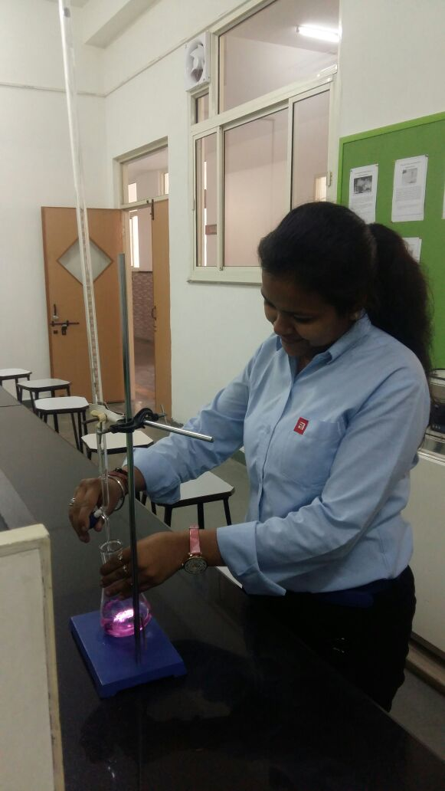
Hardness-
Types
Permanent hardness-Cl, NO ions
Temporary hardness-Ca, Mg ions
In(ppm)
Students finding hardness of water
Soft water | 0-17
Slightly hard | 17-60
Moderate hard | 60-120
Hard water | 120-180
Very hard | Above 180
Hardness (in ppm)
Indicator –EBT
(Erichrome black-T)
Titrating sol -
EDTA

Slide 8
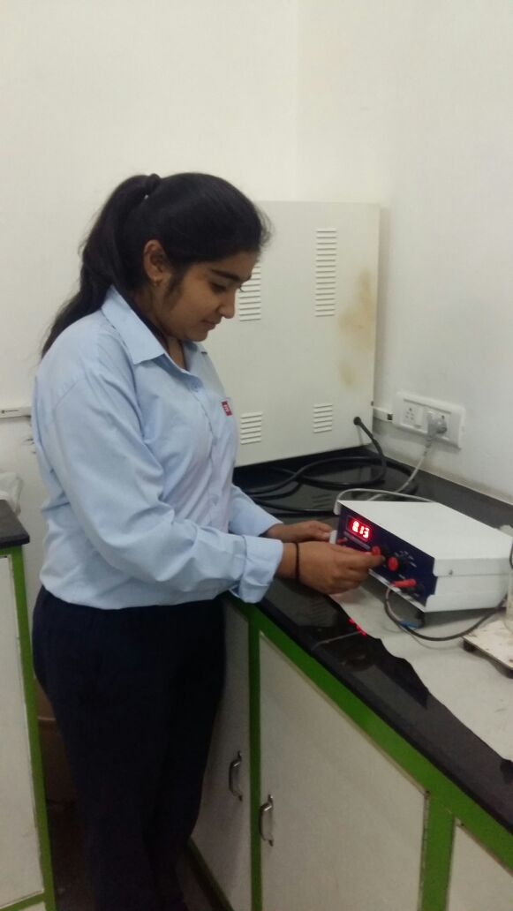
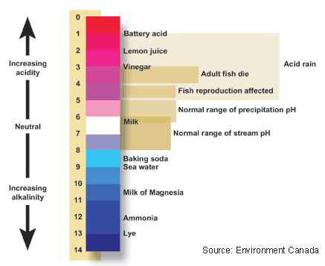
pH-
Using
ph meter
Hydrogen ion concentration
Dissolved Oxygen (in ppm)
Students performing ph experiment

Slide 9
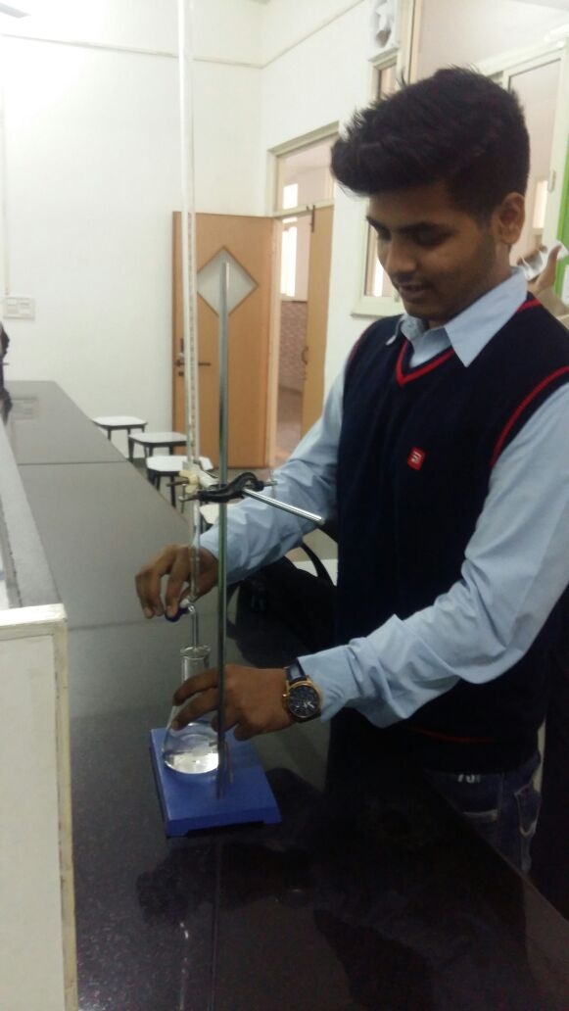
Residual Chlorine-
Students performing experiments
It is the inactive form of chlorine.
Uses
Water cleaning
Prevent corrosion
Tap water | No chlorine content
Tube well water | No chlorine content
Hand pump water | No chlorine content
R.O water | No chlorine content
R.O waste water | No chlorine content

Slide 10
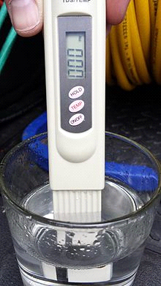
TDS(Total Dissolved solids) -
It is the sum of no of cations and anions
TDS
Meter
Sources of water | observation
Hand pump water | 456
Tap water | 421
Tube well | 330
R.O water | 365

Slide 11
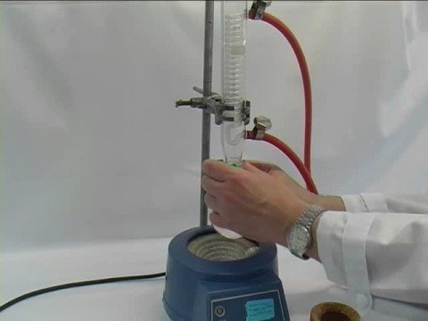
Chemical Dissolved Oxygen -
Amount of oxygen that can be consumed by reactions
Fluxing
apparatus
Sources of water | C.O.D (ppm)
Tap Water | Negligible
Hand Pump Water | Negligible
Tube Well Water | Negligible
R.O. Water | Negligible

Slide 12
WHO Standards- (drinking water)
Dissolved Oxygen
18ppm
Hardness
300ppm
Residual Chlorine
0.2ppm
pH
6.5-8.5
TDS
500ppm

Slide 13
Conclusion-
Residual chlorine
Remaining chlorine concentration after chlorine demand is met.
Reaction with organic and inorganic material, metals and non-metals are prior to disinfection.
Dissolved oxygen.
Dissolved oxygen for the tested sample is 7.9mg/l. Test result shows that water is healthy and is fit for aquatic life.
For healthy water body dissolved oxygen is about 8 parts per million.
PH
An acidic solution has high concentration of hydrogen ions greater than that of pure water.
A basic solution has low hydrogen ions concentration less than that of pure water.
Hardness-
Temporary hardness can be removed by boiling.
Permanent hardness can be removed by Winkler’s Method

Slide 14
References-
http://www.lenntech.com/why_the_oxygen_dissolved_is_important.htm
https://www.ncbi.nlm.nih.gov/pmc/articles/PMC3775162/
http://www.water-research.net/index.php/water-treatment/tools/hard-water-hardness
http://www.lenntech.com/why_the_oxygen_dissolved_is_important.htm
https://water.usgs.gov/edu/ph.html
https://www.corrosionpedia.com/definition/267/chlorine-demand

